Slide 1
AI, ML AND DL
RESEARCH BY:
BISHESH RANA

Slide 2
CONTENT
Introduction of AI, ML, DL
Algorithm
Optimizer
Modules

Slide 3
Introduction Artificial intelligence
AI refer to machine that can learn, reason and act for themselves like human being.
AI system make their own decision according to knowledge base.
Knowledge base is like a database which store fact and table.
AI is large field computer science which is combination of Mathematics, Robotics, machine learning, Deep learning, image processing, natural language processing.
AI uses the different type of algorithm to make prediction.

Slide 4
Machine Learning
Machine learning is subfield of artificial intelligence.
Machine learning concern with the computer program that automatically improve their performance through experience.
Discover new knowledge from large datasets.
It replace some monotonous task which require some intelligence.
For example character recognition, filter spam emails etc.
ML require large amount of datasets, computational power etc.

Slide 5
Types of machine learning
Supervised learning
Unsupervised learning
Reinforcement learning

Slide 6
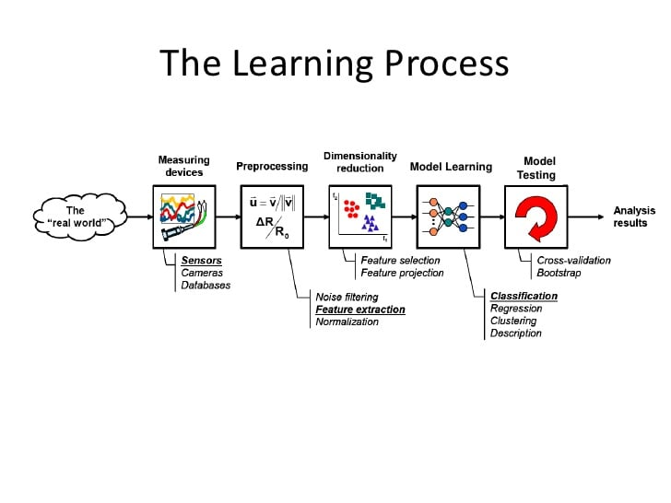

Slide 7
Algorithms
Linear Regression.
Logistic Regression.
Decision Tree.
SVM.
Naive Bayes.
kNN.
K-Means.
Random Forest.

Slide 8
Deep Learning
Deep Learning is a subfield of machine learning concerned with algorithms inspired by the structure and function of the brain called artificial neural networks.
It uses a large amount of datasets for prediction of objects.
These neural networks attempt to simulate the behavior of the human brain.
Deep learning learn feature automatically from image through the gradient decent and back propagation.

Slide 9
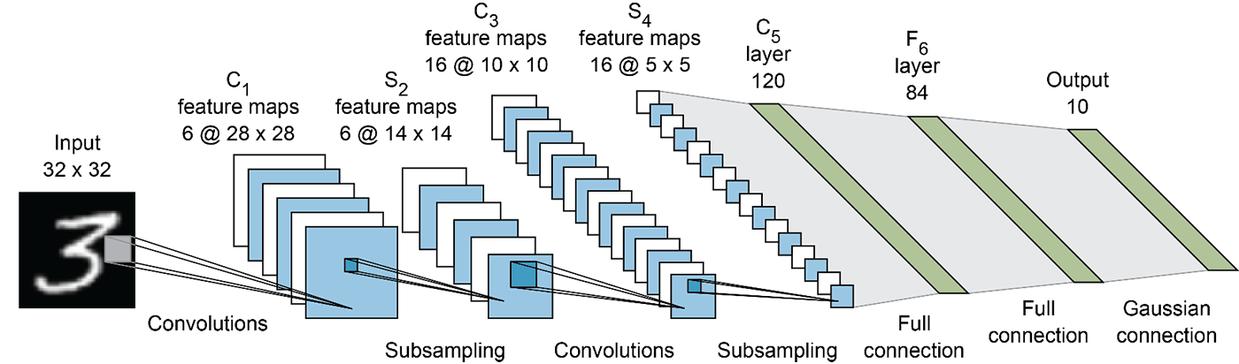
Working principle

Slide 10
Algorithm
Convolutional neural network
Long short term memory network
Recurrent neural network
Autoencoders
Multilayer perceptrons

